Slide 1

Decision Trees

Slide 2
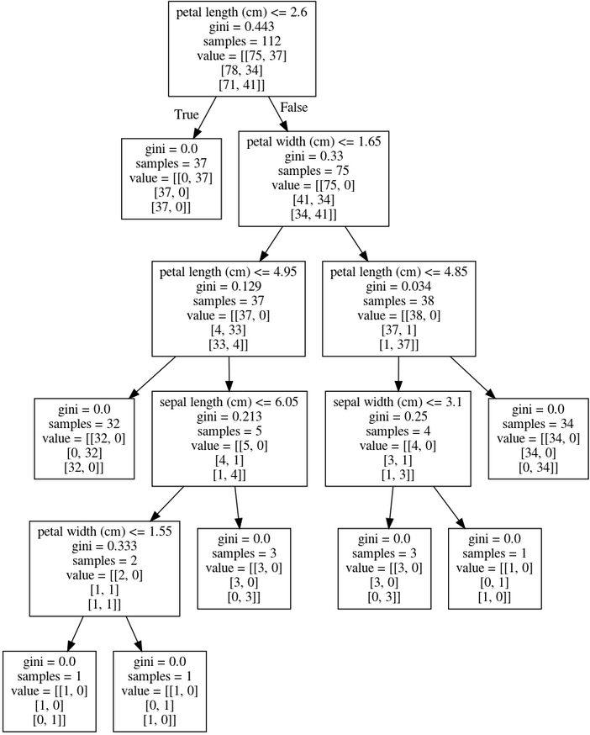
Decision Tree
A Decision Tree is a Flow Chart, and can help you make decisions based on previous experience.

Slide 3

Implementation using SKLearn Library in python #1
import pandas as pd
import numpy as np
import matplotlib.pyplot as plt
dataset = pd.read_csv("bill_authentication.csv")
dataset.shape
dataset.head()

Slide 4
X = dataset.drop('Class', axis=1)
y = dataset['Class']
from sklearn.model_selection import train_test_split
X_train, X_test, y_train, y_test = train_test_split(X, y, test_size=0.20)
from sklearn.tree import DecisionTreeClassifier
classifier = DecisionTreeClassifier()
classifier.fit(X_train, y_train)
y_pred = classifier.predict(X_test)

Slide 5
Implementation using SKLearn Library in python #2
import pandas as pd
from sklearn.tree import DecisionTreeClassifier
from sklearn.model_selection import train_test_split
from sklearn import metrics
Columns = ['pregnant', 'glucose', 'bp', 'skin', 'insulin', 'bmi', 'pedigree', 'age', 'outcome']
Dataset = pd.read_csv("diabetes.csv", header=None, names= Columns)

Slide 6
Dataset.columns = Columns
Attributes =['pregnant','insulin','bmi','age','glucose','bp','pedigree']
X = Dataset[Attributes] # Feature vector (independent variables)
y = Dataset.outcome # Target variable (dependent variable)
X_train, X_test, y_train, y_test = train_test_split(X, y, test_size=0.2, random_state=1) # 80% training and 20% test
DTClassifier = DecisionTreeClassifier()
DTClassifier = DTClassifier.fit(X_train,y_train)
y_pred = DTClassifier.predict(X_test)
print ("Accuracy of DT:", metrics.accuracy_score(y_test, y_pred))

Slide 7

More Practice
https://www.w3resource.com/python-exercises/python-conditional-statements-and-loop-exercises.php

Slide 8

Resources
https://www.w3schools.com/python/python_ml_decision_tree.asp
https://www.geeksforgeeks.org/decision-tree-implementation-python/
https://stackabuse.com/decision-trees-in-python-with-scikit-learn/

